Slide 1
Kubernetes (K8s)
Container Orchestration Tool

Slide 2
Introduction
Kubernetes is an open-source container orchestration system for automating software deployment, scaling, and management.
Kubernetes orchestration allows you to build application services that span multiple containers, schedule containers across a cluster, scale those containers, and manage their health over time.
Google originally designed Kubernetes

Slide 3
Introduction
Kubernetes allows us to host the applications in the form of containers in an automated way.
Dockers will only run containers, if in any case the container fails/stopped/killed, the docker will not help us, here is where Kubernetes plays an important role, Kubernetes cluster will be responsible in creating a new container and managing various containers.

Slide 4
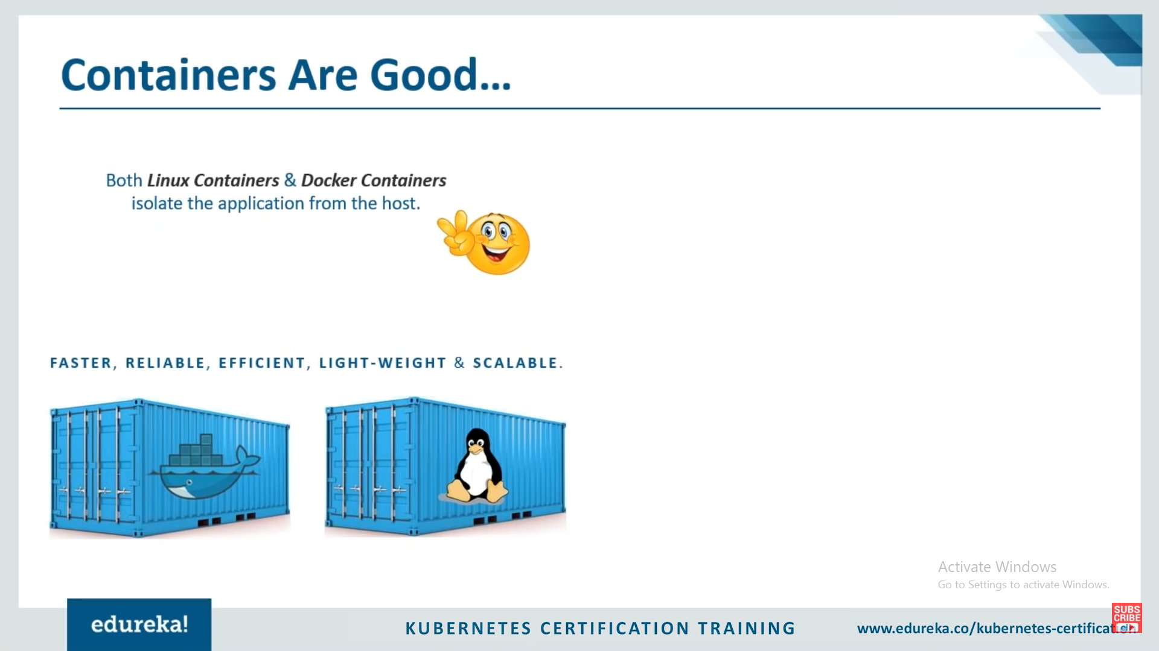

Slide 5
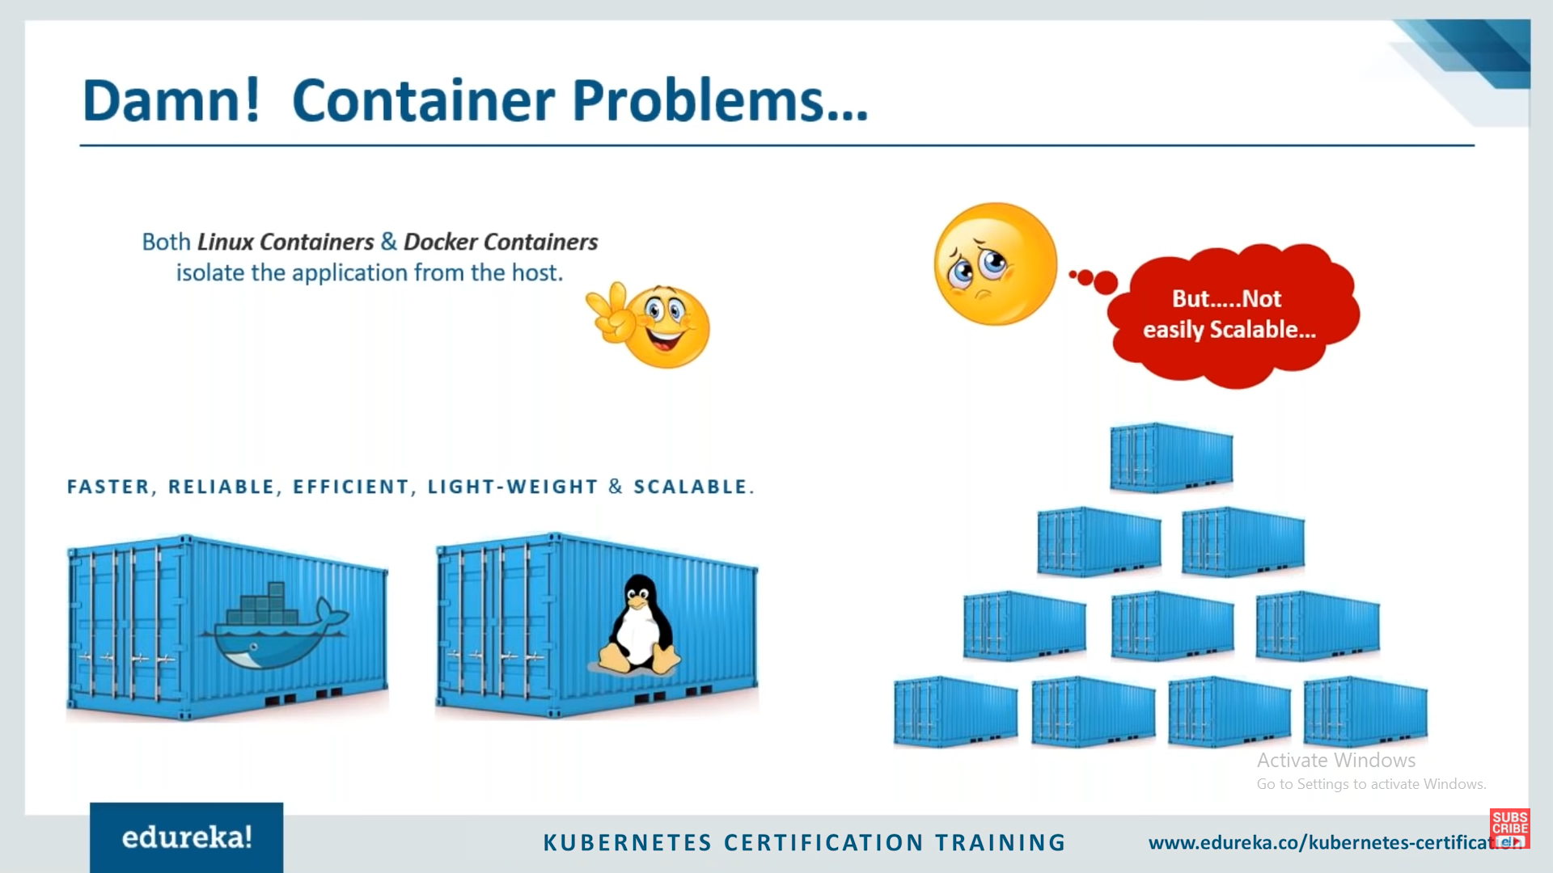

Slide 6
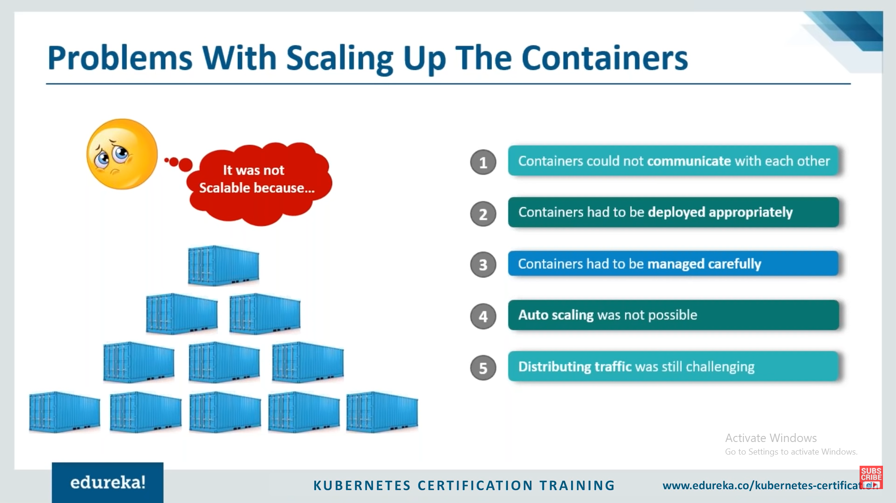

Slide 7
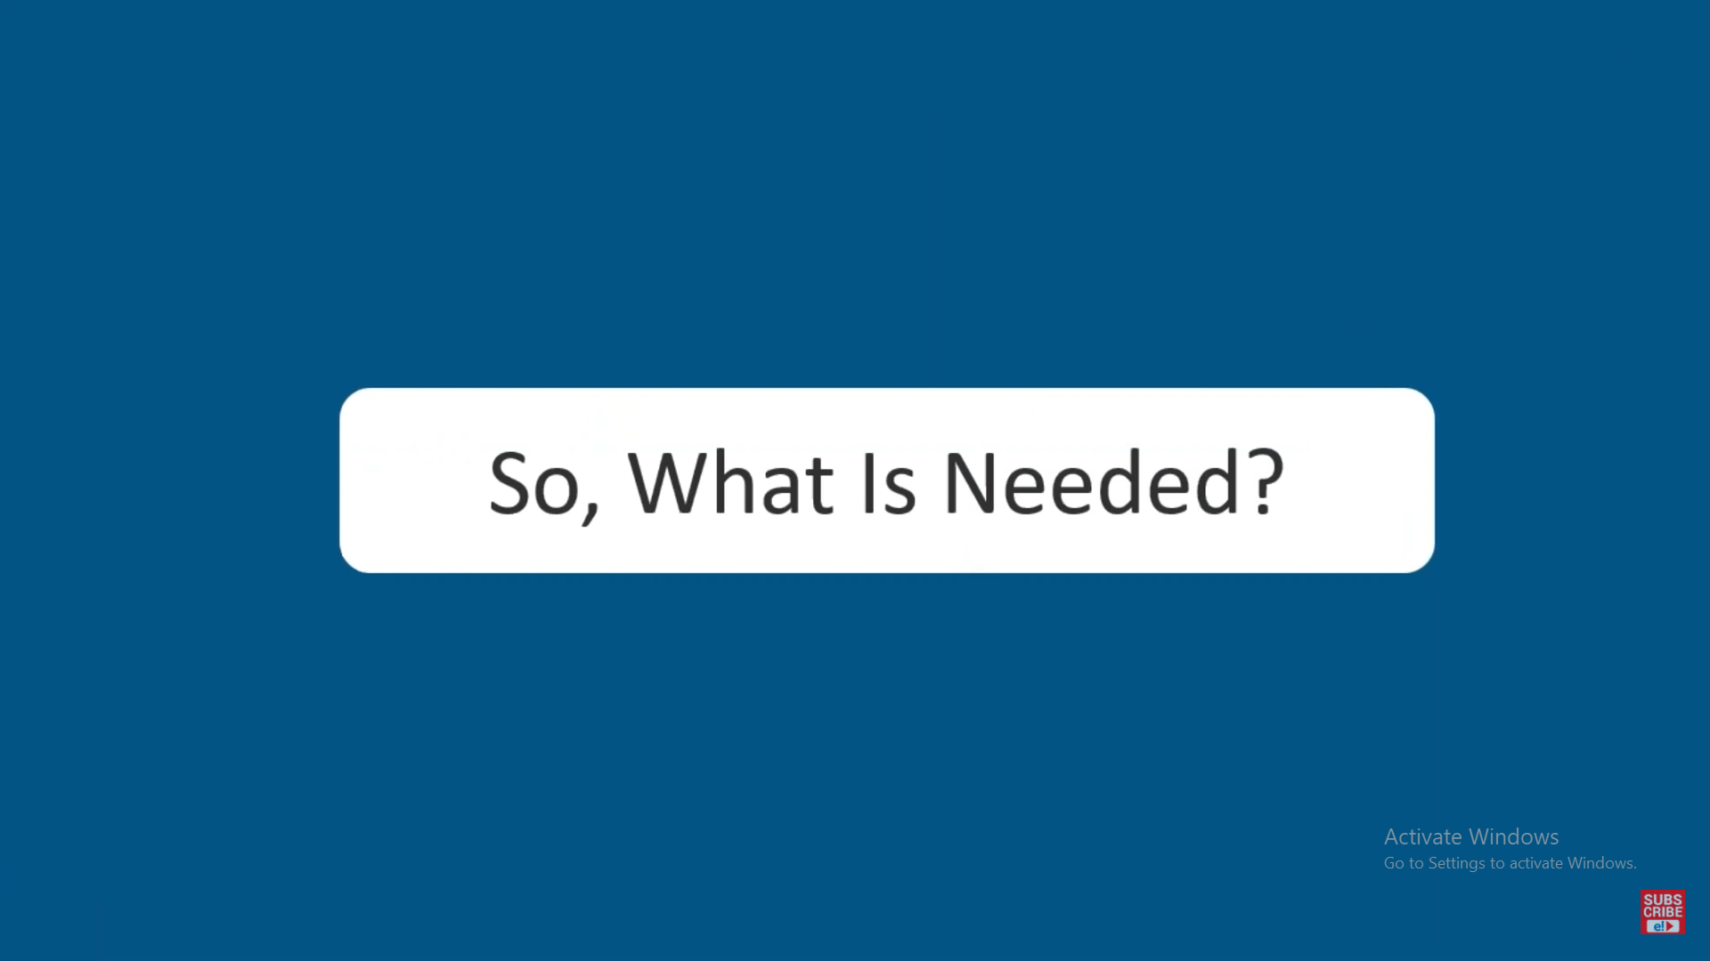

Slide 8
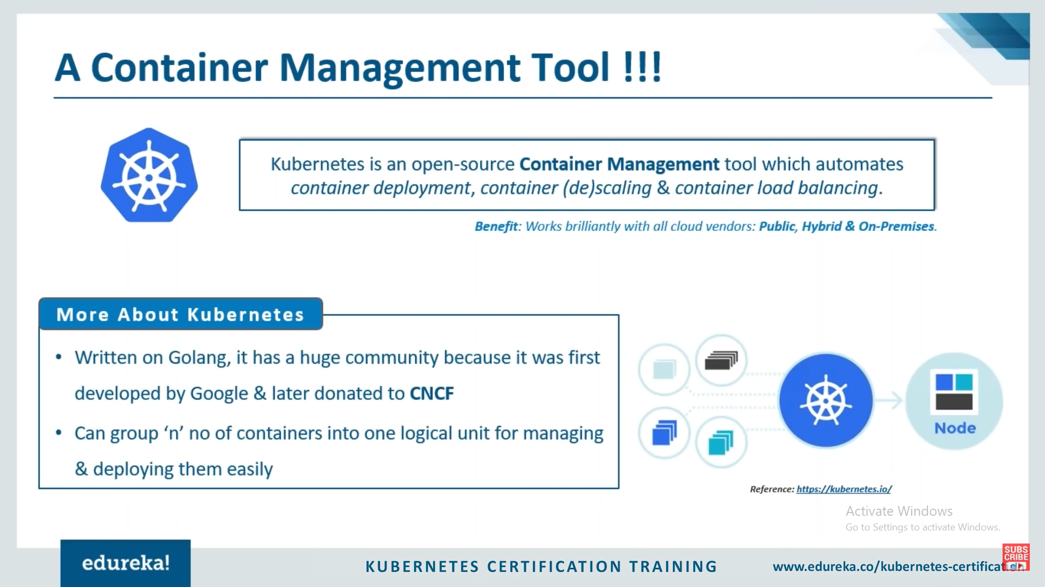
Cloud native computing foundation

Slide 9
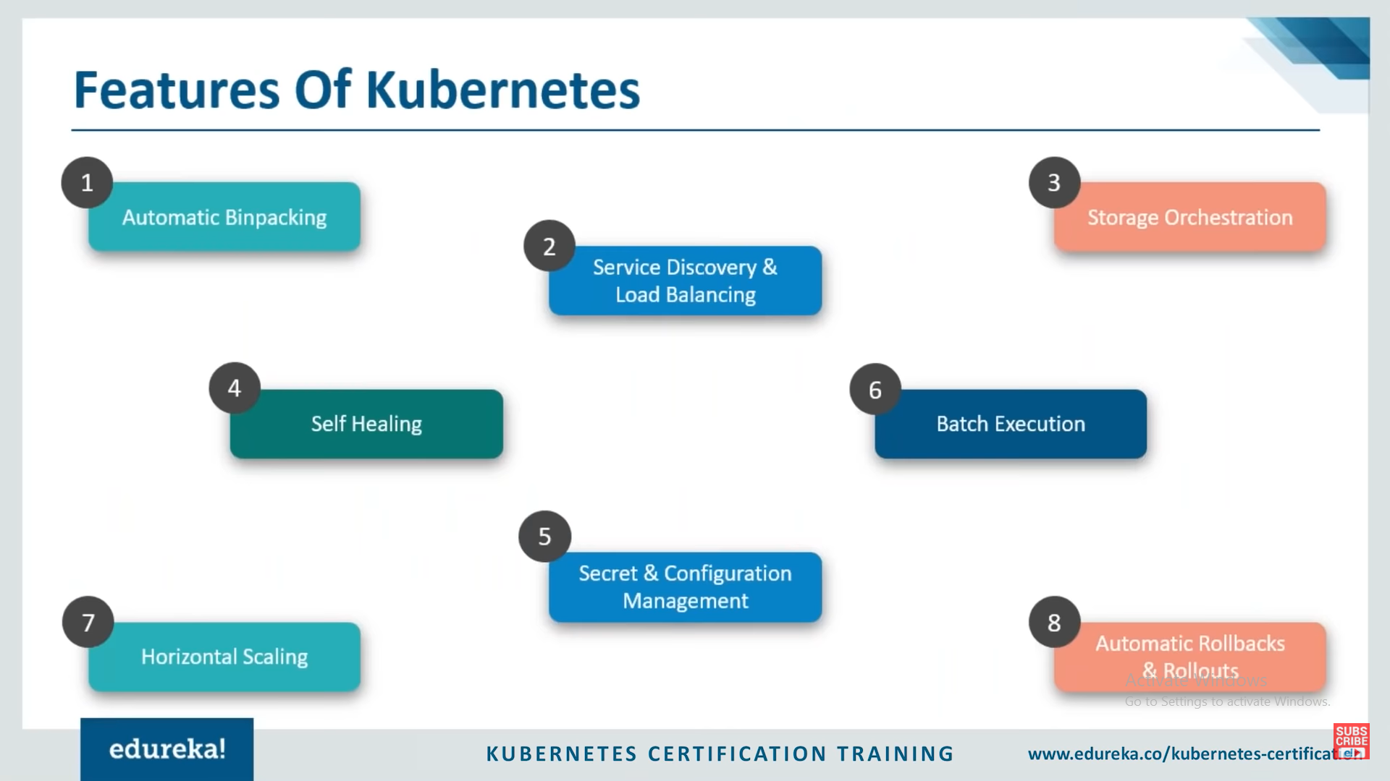

Slide 10
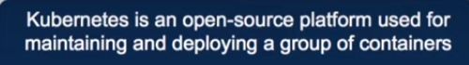
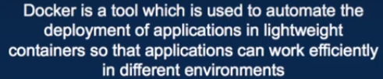
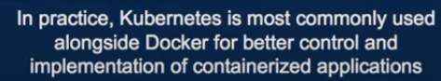
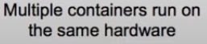
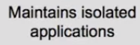
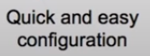




kubernetes Vs Docker

Slide 11
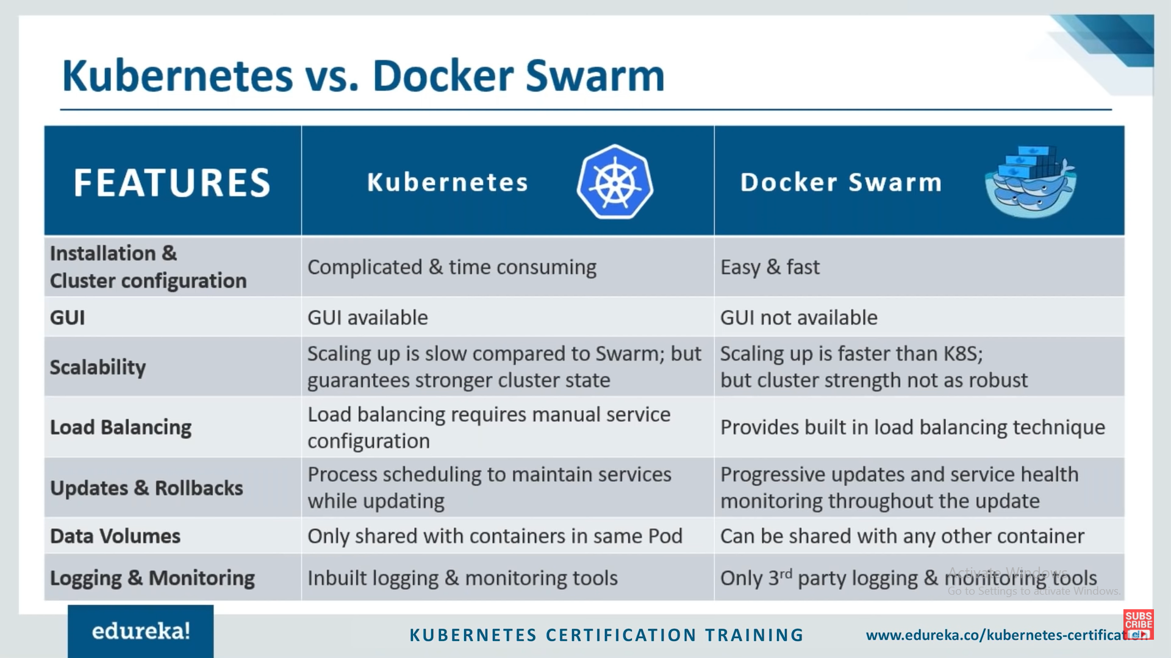

Slide 12
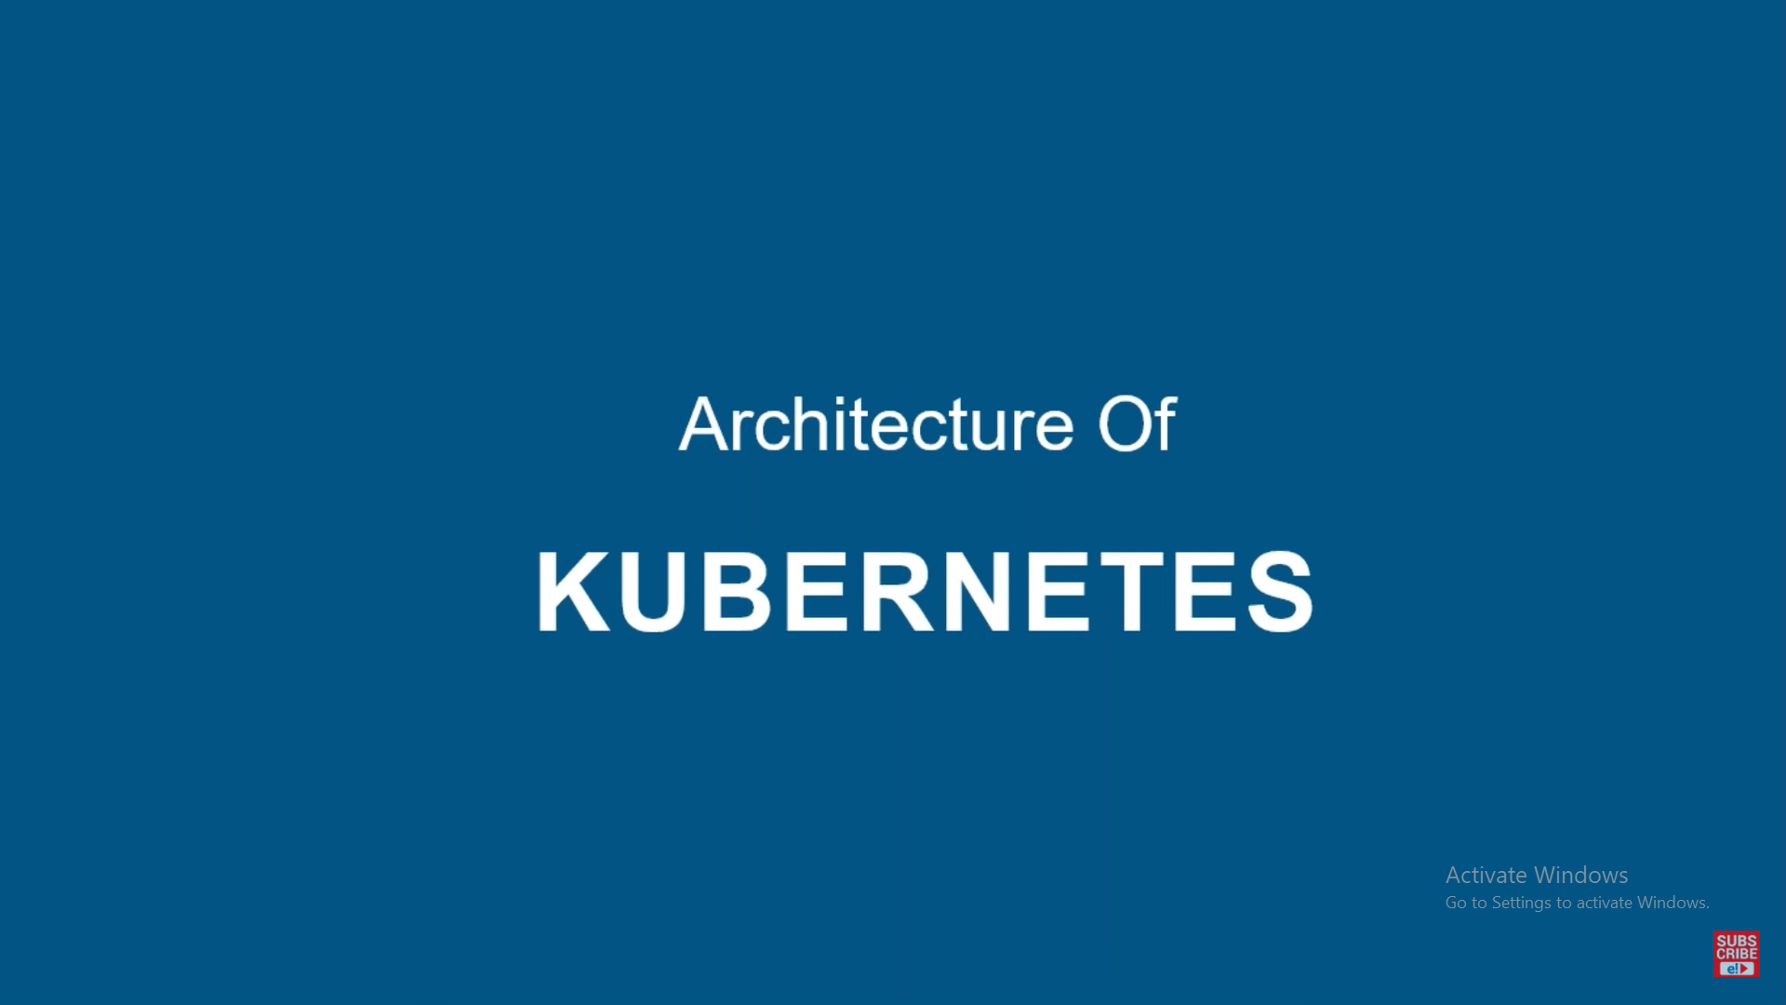

Slide 13
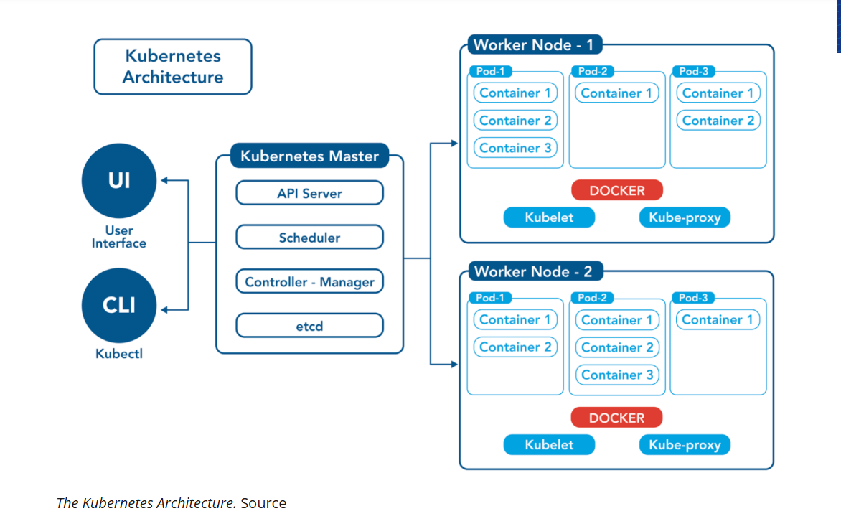
Kubernetes Architecture

Slide 14
A Kubernetes architecture diagram illustrates the key components and their interactions within a Kubernetes cluster. The architecture follows a master-worker model, with the Control Plane (Master Node) managing the cluster and Worker Nodes running the containerized applications.
Control Plane (Master Node) Components:
kube-apiserver:
The central communication hub, exposing the Kubernetes API. It handles all API requests, validates them, and updates the cluster's state in etcd.
etcd:
A highly available key-value store that serves as Kubernetes' backing store for all cluster data. It stores configuration data, state, and metadata.
kube-scheduler:
Responsible for assigning pods to available worker nodes based on resource requirements, policies, and other constraints (e.g., affinity, taints).

Slide 15
kube-controller-manager:
Runs various controllers that regulate the cluster's state. Examples include the Node Controller (manages node lifecycle), Replication Controller (ensures desired number of pod replicas), and EndpointSlice Controller.
cloud-controller-manager (Optional):
Integrates Kubernetes with cloud provider APIs to manage cloud-specific resources like load balancers, persistent volumes, and node provisioning.
Worker Node Components:
kubelet:
An agent running on each worker node. It communicates with the API server, receives pod specifications, and ensures that containers within those pods are running and healthy.
kube-proxy:
Maintains network rules on nodes, enabling network communication to and from pods, and performs network proxying for Kubernetes services.
Container Runtime:
Software responsible for running containers (e.g., containerd, CRI-O, Docker). It pulls container images, manages container lifecycle, and handles resource isolation.
Other Key Elements:

Slide 16
Pods:
The smallest deployable unit in Kubernetes, encapsulating one or more containers, shared storage, and network resources.
Services:
An abstraction that defines a logical set of pods and a policy by which to access them.
Deployments:
Manages the desired state of a set of pods, enabling declarative updates and rollbacks.
Persistent Volumes/VolumeClaims:
Provide persistent storage for applications running in pods.
This architecture ensures high availability, scalability, and automated management of containerized workloads, making Kubernetes a robust platform for modern application deployments.

Slide 17
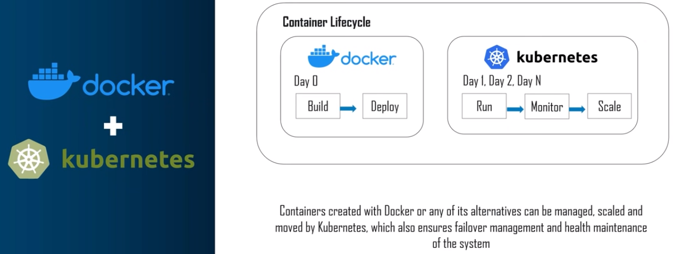
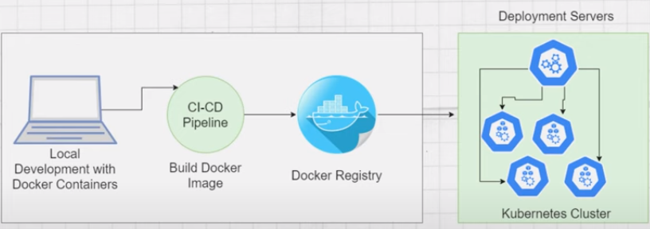
docker+kubernetes

Slide 18
Minikube installation (Note: Check Docker has been installed before the minikube installtion)

Slide 19
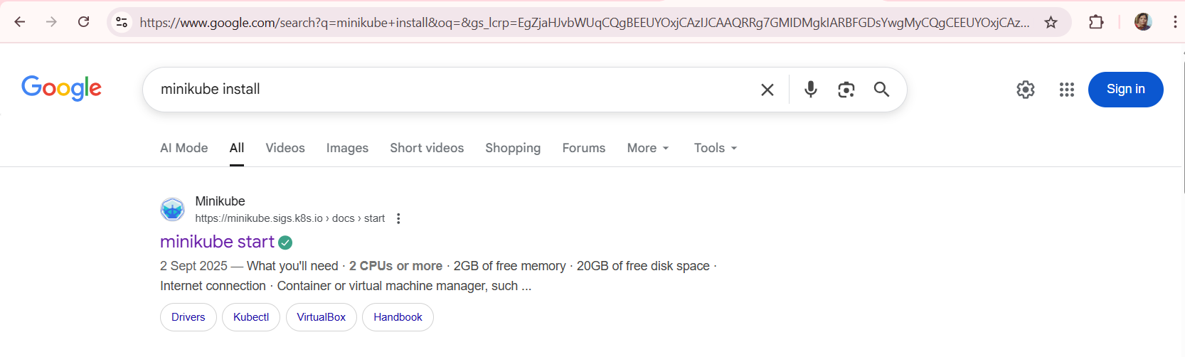
Search for Minikube Install in Google, Click on the highlighted link as shown

Slide 20
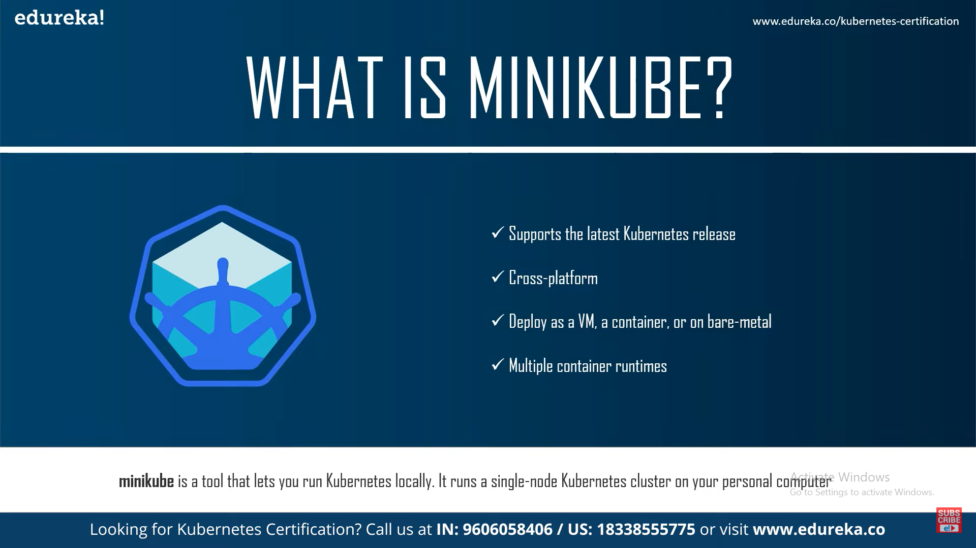

Slide 21
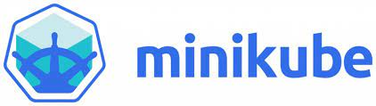
WHAT IS MINIKUBE?
Minikube is a lightweight Kubernetes implementation that creates a VM on your local machine and deploys a simple cluster containing only one node. Minikube is available for Linux, macOS, and Windows systems

Slide 22
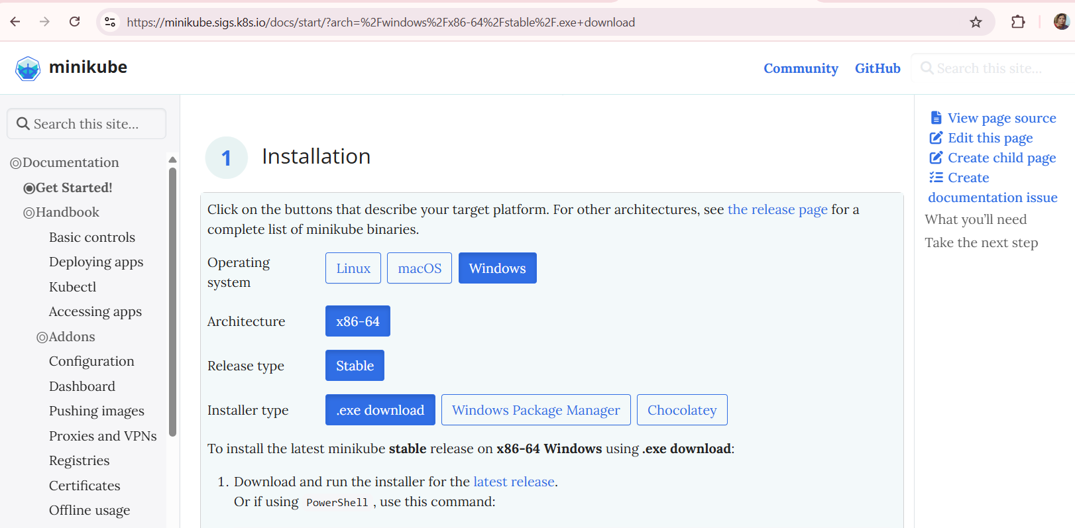
Make sure the following options are highlighted and click on latest release to download the executable file

Slide 23
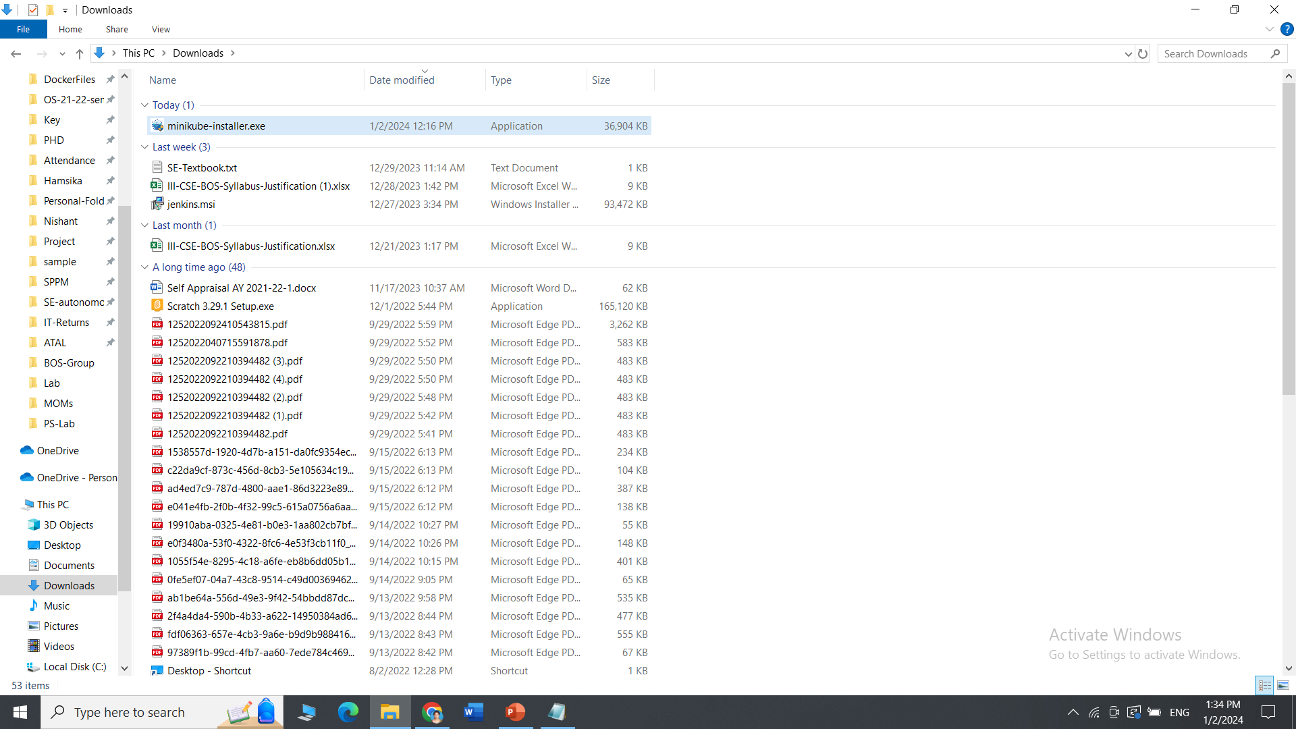
The minikube-installer is downloaded successfully

Slide 24
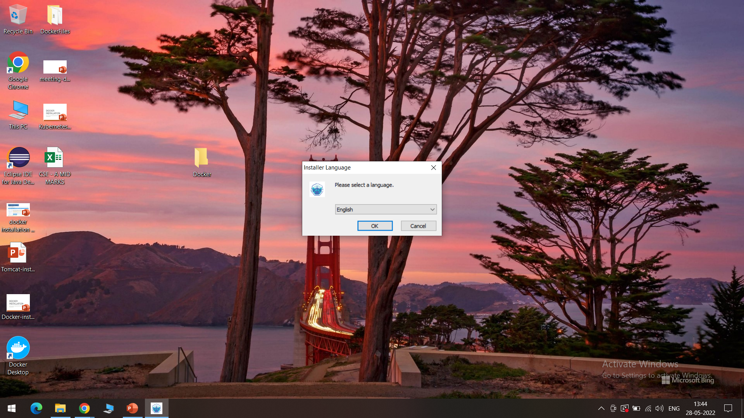
Select the language preferable English

Slide 25
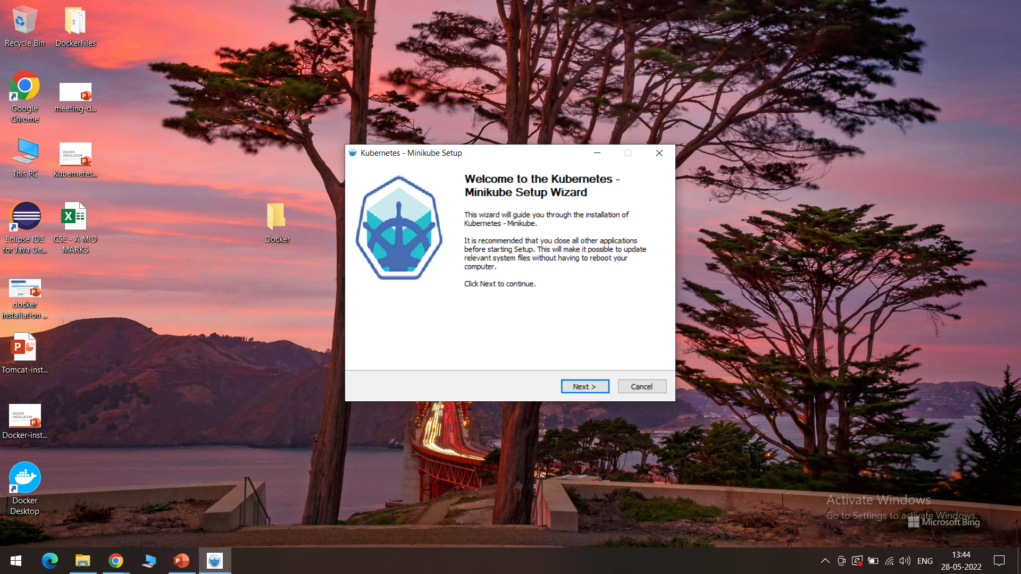
Click on Next

Slide 26
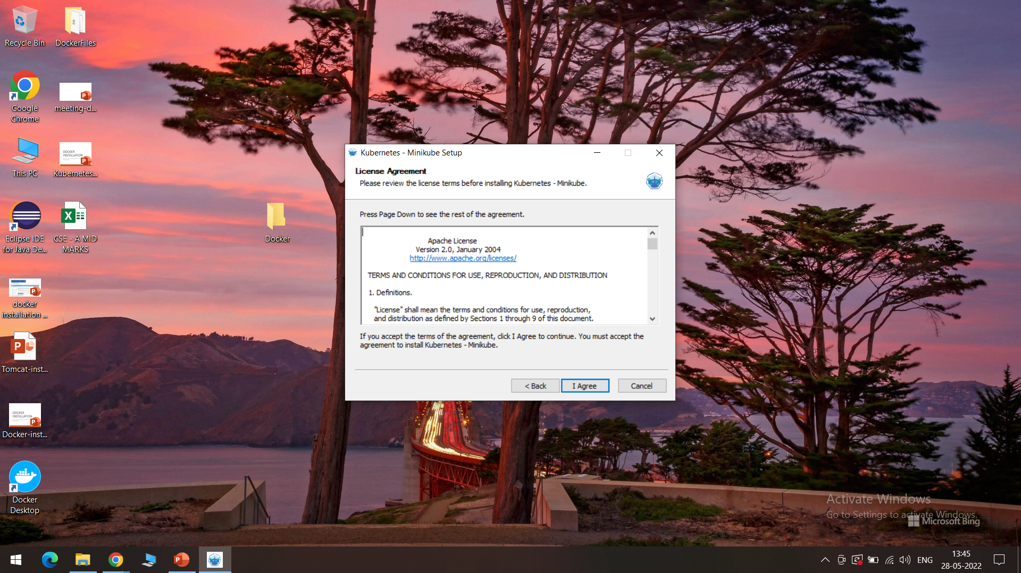
Agree the license

Slide 27
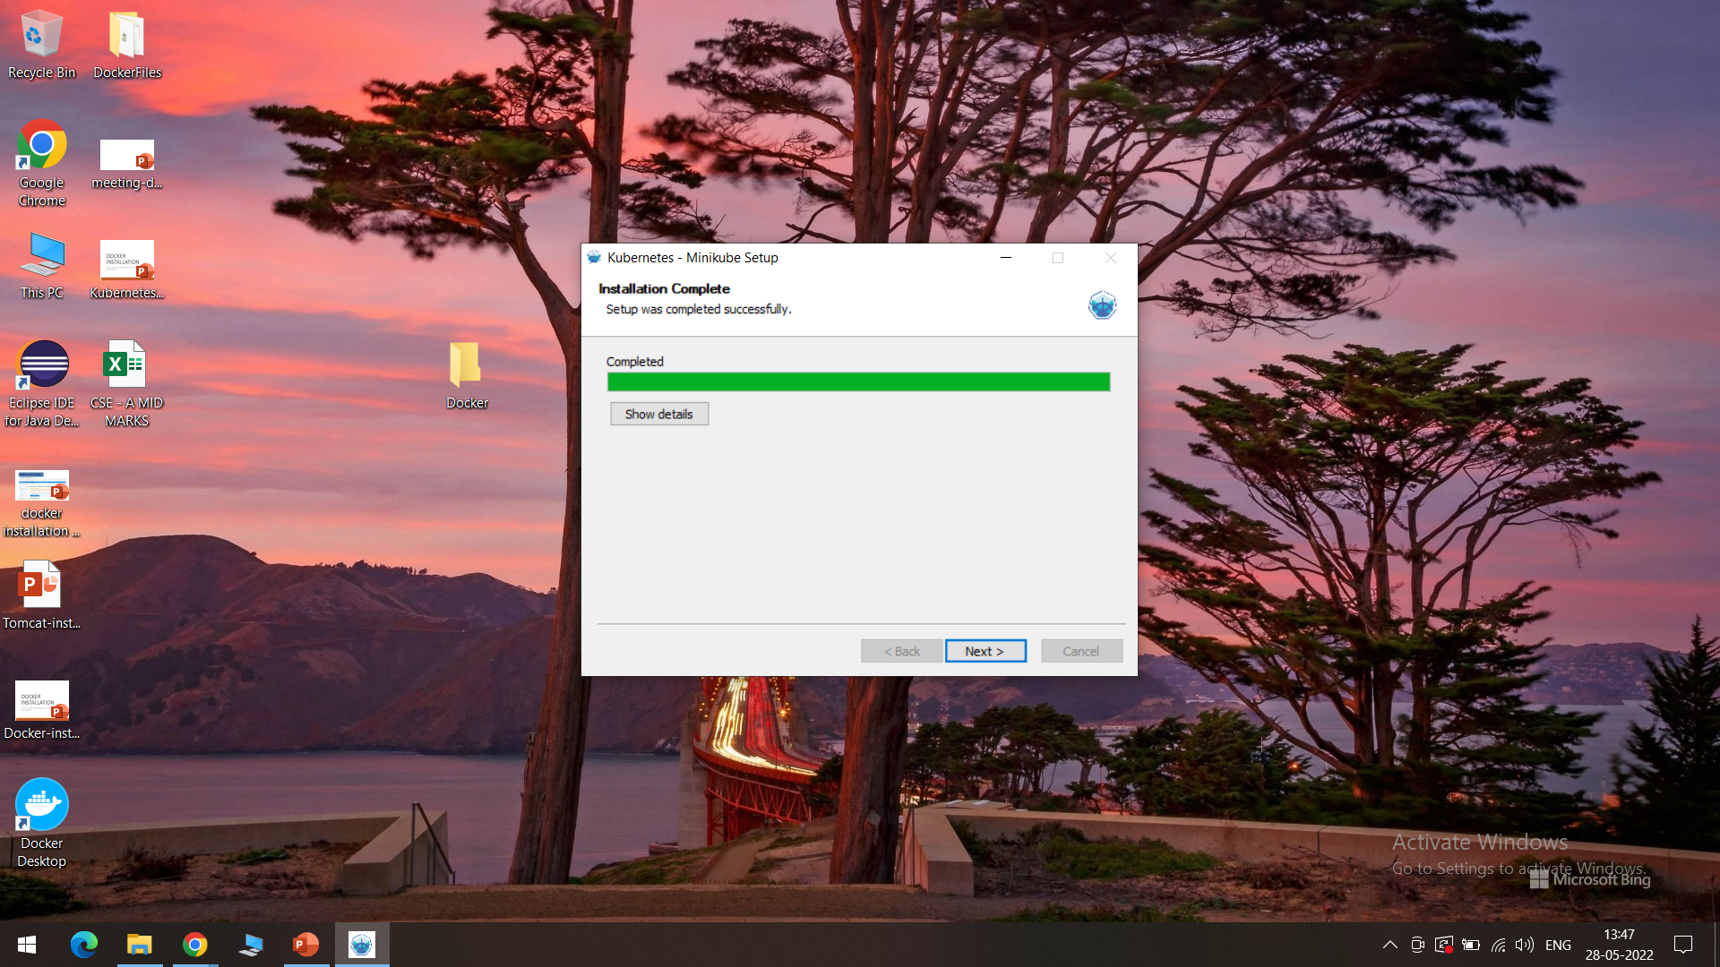
Installation is successfully completed, Click on Next

Slide 28
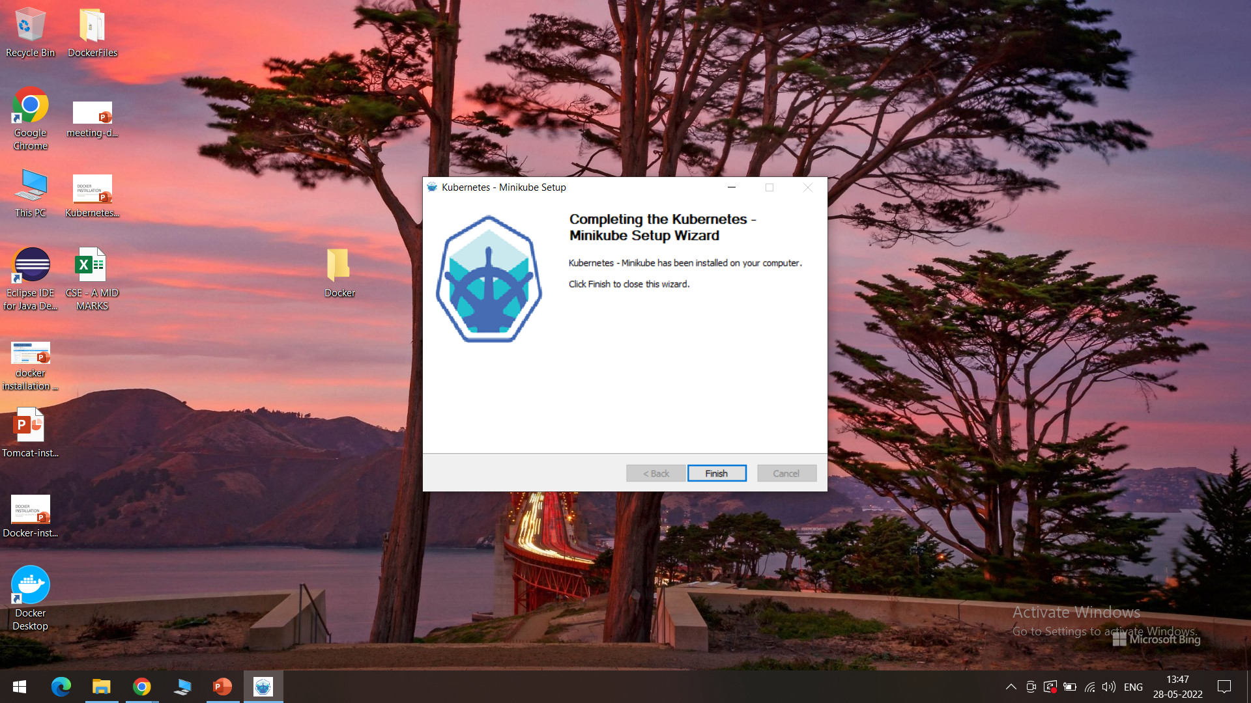
For learning purpose, Minikube version is sufficient, click on Finish

Slide 29
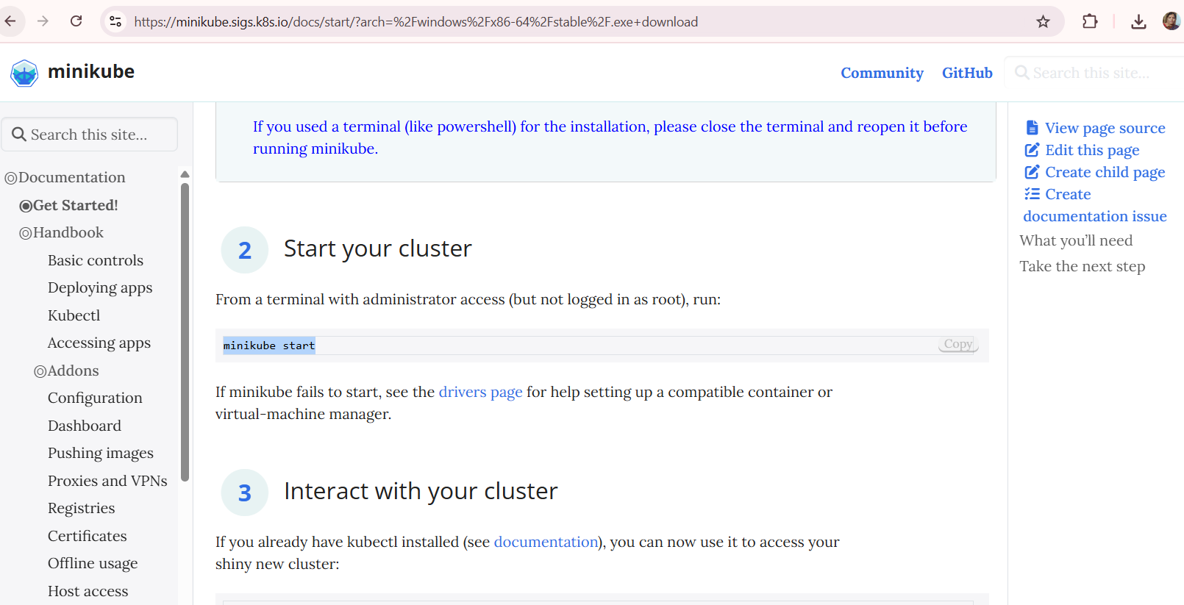
After the installation, scroll down in the same previous document, we will now get access to cluster as shown, use these two commands as displayed to interact with your cluster → follow the steps from next slide

Slide 30
Copy the first command as shown

Slide 31
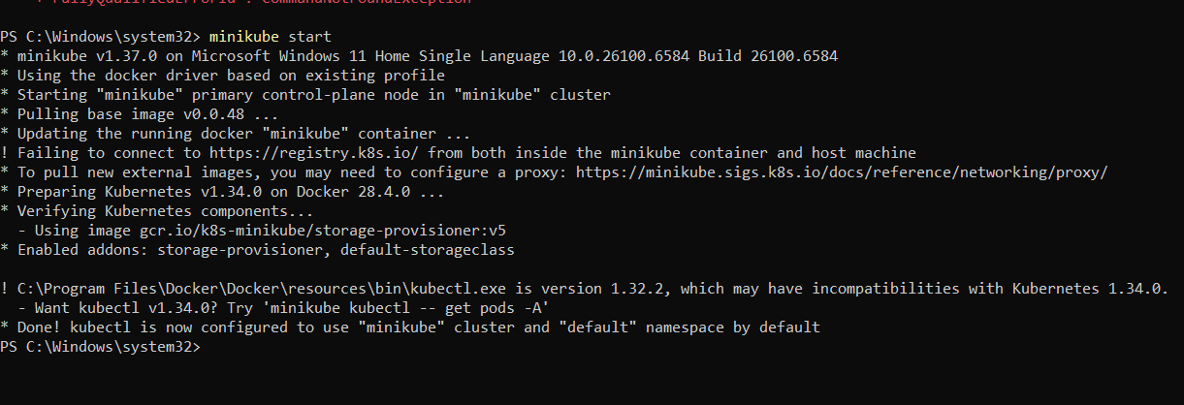
Open the command prompt/ Windows PowerShell always in administrative mode and paste the command as shown

Slide 32
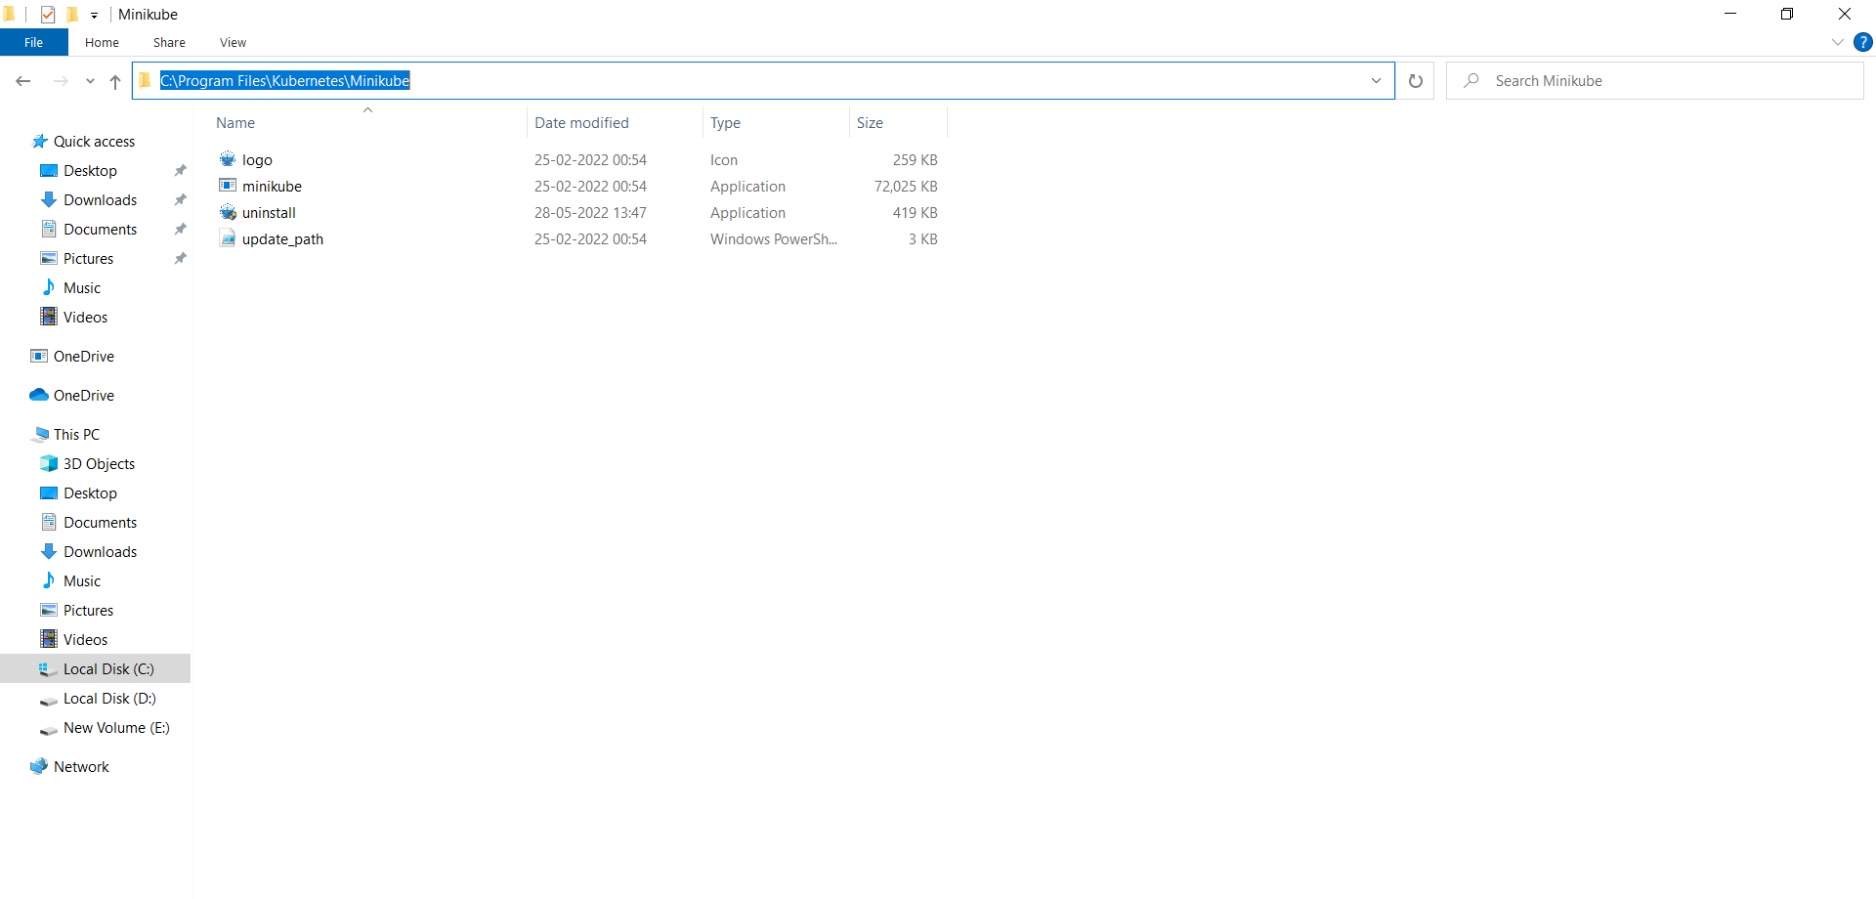
Sometimes it gives an error saying, internal command, in that case we need to set the path in environmental variables, firstly copy the minikube path as shown

Slide 33
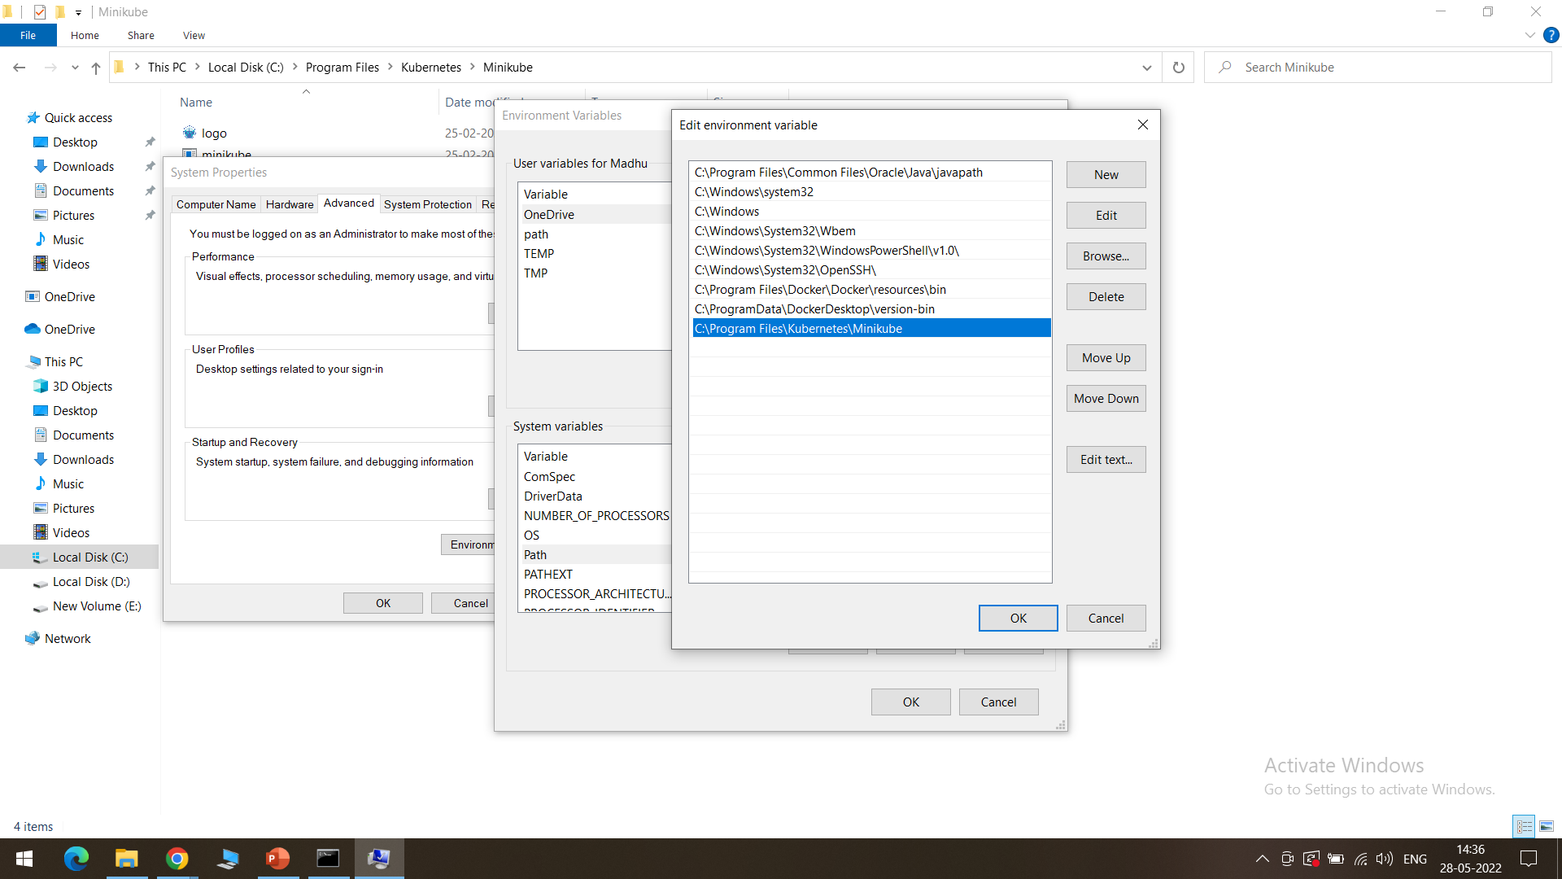
Open Environmental variables->DoubleClick path in System variables and paste the copied path as shown->click Ok

Slide 34
minikube installed successfully

Slide 35
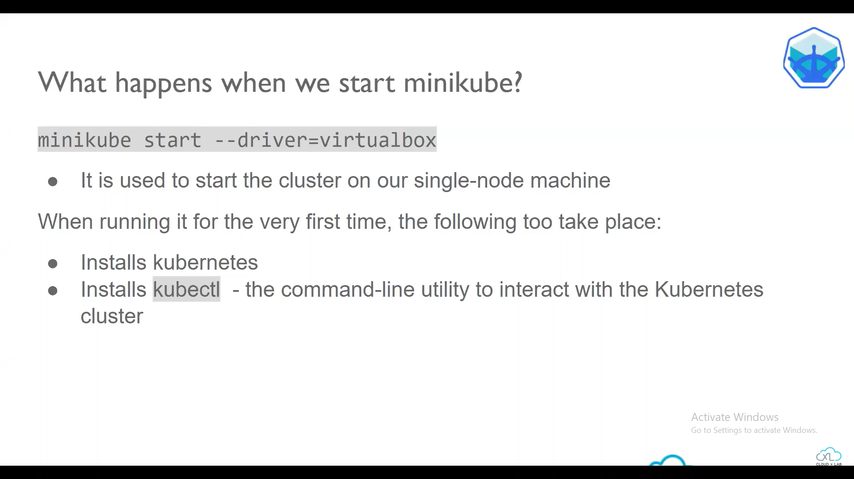

Slide 36
Exercise - 1

Slide 37
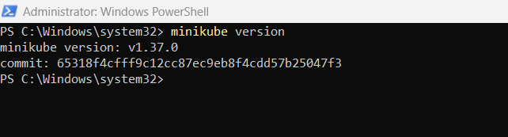
We can start minikube using Hyper-V, Docker or VM minikube start –vm-driver=virtualbox if I use only minikube start by default Linux: docker (if installed) or kvm2, Windows: hyperv, macOS: hyperkit will be used.

Slide 38
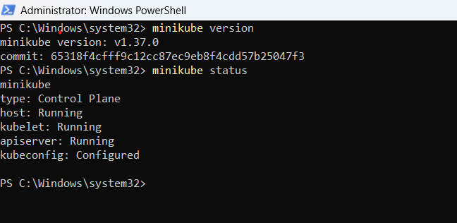
The minikube status command is used to check and display the current status of the Minikube cluster running on your local machine. In simple terms, it provides information about whether the Minikube cluster is up and running or if it's stopped.

Slide 39
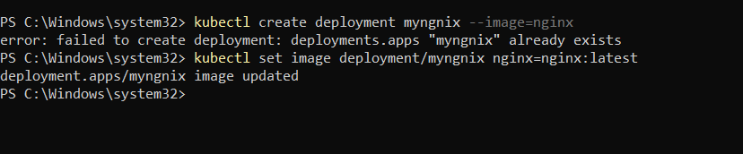
Lets deploy an application in Kubernetes kubectl create deployment myngnix --image=nginx if already created then kubectl set image deployment/myngnix nginx=nginx:latest kubectl is a command-line tool used in Kubernetes to interact with and manage Kubernetes clusters. This command is like telling Kubernetes to create a group named "mynginx" that will run an application (Nginx) inside it. This is a common way to start running and managing applications on a Kubernetes cluster.

Slide 40
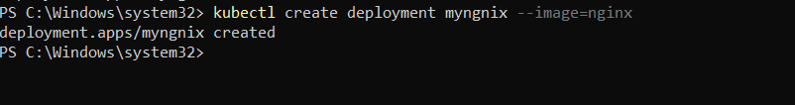
Nginx (pronounced "engine-x") is a web server software that helps deliver and manage websites on the internet. It can handle tasks like serving web pages, processing HTTP requests, and load balancing, making it a crucial component in hosting and delivering web content efficiently. You've just told Kubernetes to create a team (deployment) called "myngnix" that will manage an application (Nginx) for you. Seeing "created" means Kubernetes has successfully done that for you. Now, your Nginx application is ready to run and be managed by Kubernetes.

Slide 41
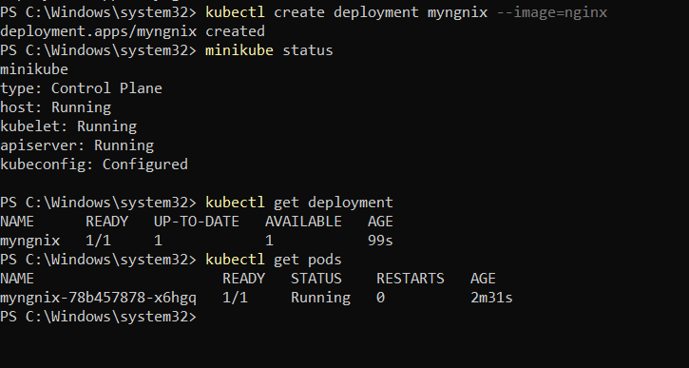
kubectl get deployment when you execute this command, Kubernetes responds by showing you a list that includes the names of your deployment groups, how many instances of your applications are running, and other useful details. kubectl get pods running kubectl get pods is a quick way to check which of your applications are currently active and doing their jobs inside the Kubernetes system. *Here the status shows that the containercreating*

Slide 42
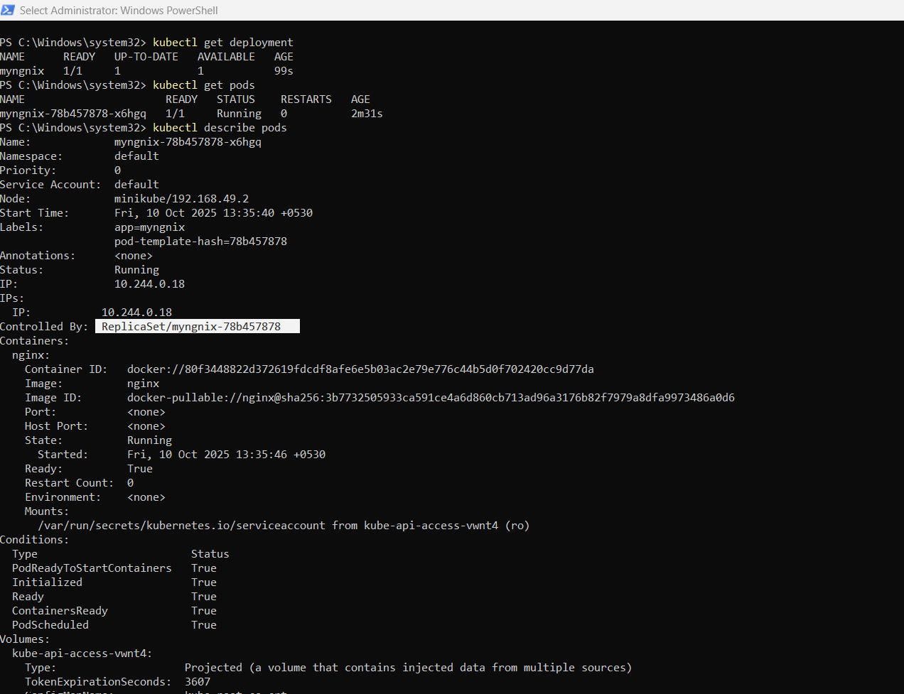
This command opens up each pod's file and tells you everything about it. It's like reading a detailed report that includes the current state, recent events, and all the configurations of each of your applications.
So, running kubectl describe pods is a way to get a thorough understanding of what's happening inside each pod in your Kubernetes cluster. >kubectl describe pods

Slide 43
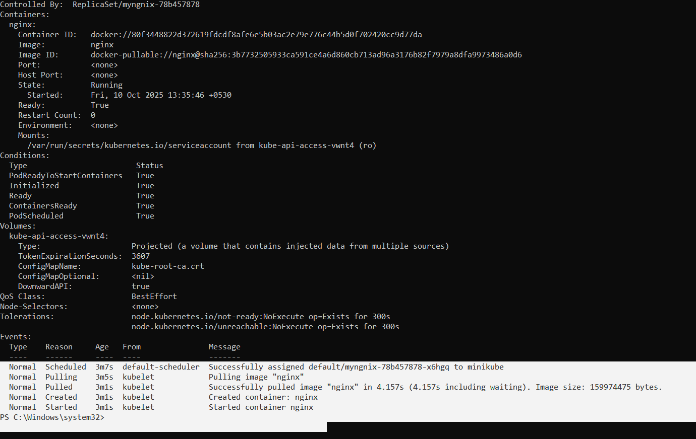
Continuation of previous

Slide 44
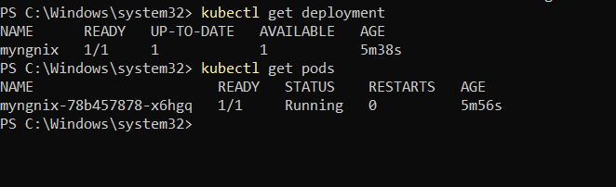
Type the following commands once again kubectl get deployment kubectl get pods Now the status of a pod is "Running," it means that the container within that pod is currently up and actively running.

Slide 45
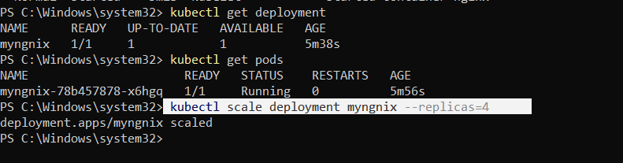
kubectl scale deployment myngnix --replicas=4 this command is used to increase the number of replicas (copies) of the "mynginx" deployment in your Kubernetes cluster to 4. scale deployment mynginx: Specifies that you want to scale the deployment named "mynginx." --replicas=4: Sets the desired number of replicas to 4. This means that Kubernetes will ensure there are four instances of your "mynginx" application running, distributing the workload and potentially improving performance or resilience. This command helps you adjust the number of running instances of your application to meet the demands of your workload or improve fault tolerance.

Slide 46
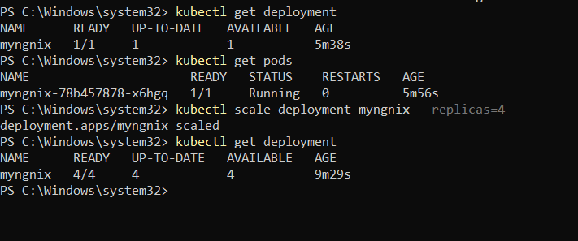
Now if we check the following command,
kubectl get deployment
We can see that 4 instances of mynginx are available
>kubectl get depolyment

Slide 47
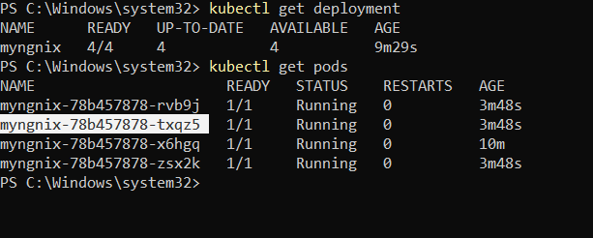
Now if we check the following command,
kubectl get pods
We can see that 4 instances of mynginx are running
kubectl get pods

Slide 48
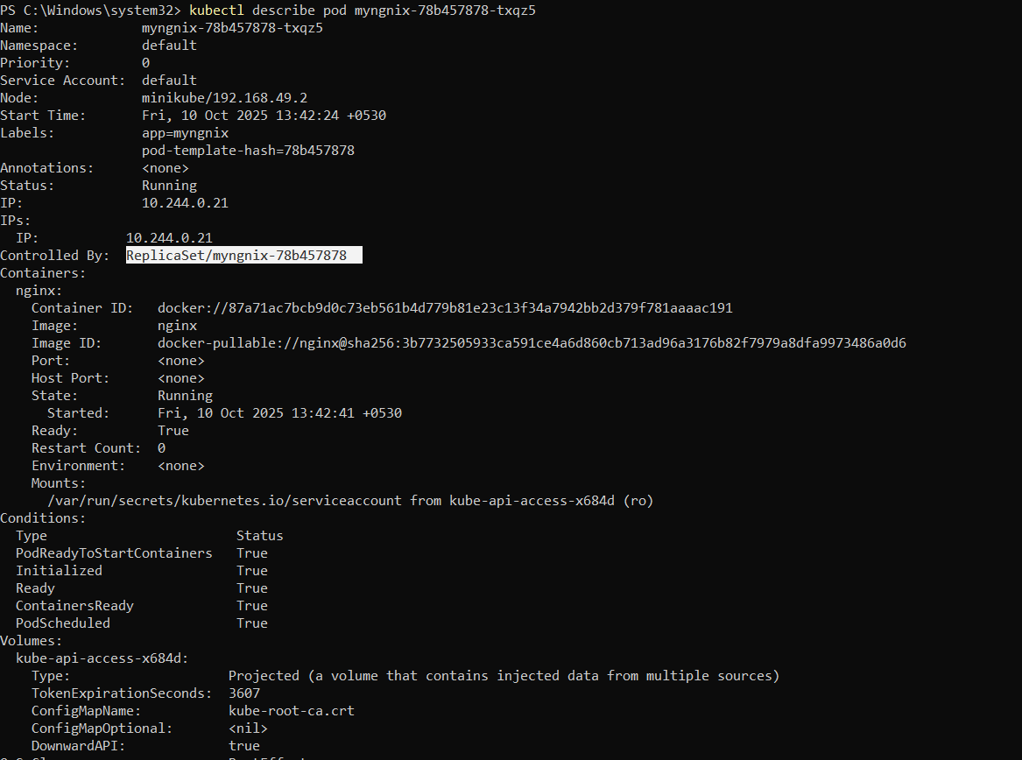
kubectl describe pod mynginx-6b78685d4d-hrc9h
This command provides detailed information about a specific pod
describe pod: Instructs Kubernetes to give detailed information about a specific pod.
mynginx-6b78685d4d-hrc9h: The unique identifier for the specific pod you want information about.
When you run this command, you'll receive information such as the pod's current status, events, labels, containers, and other details. It's a helpful command for troubleshooting or gaining insights into the configuration and state of a particular pod in your cluster. (shown in next slide)

Slide 49
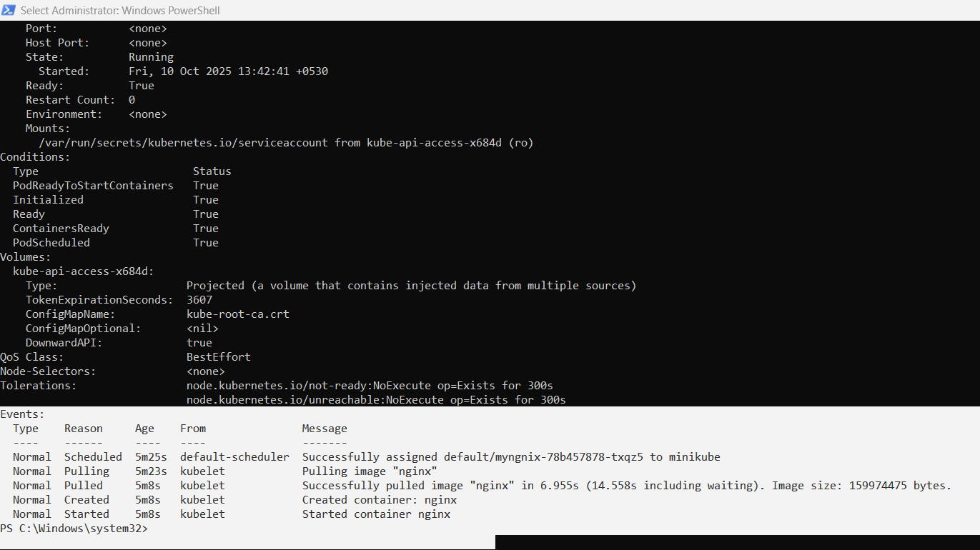

Slide 50
Expose deployment on the correct container port (80)
kubectl expose deployment myngnix --type=NodePort --port=80 --target-port=80 --name=myngnix
This command is used to make a service publicly accessible from outside the Kubernetes cluster.
expose deployment mynginx: Creates a service to expose the "mynginx" deployment.
--type=NodePort: Specifies the type of service. In this case, it's a NodePort service, which means the service will be accessible on a specific port on each node in the cluster.
--port=88: Specifies that the service should listen on port 88.
So, after running this command, you'll have a service that forwards external traffic to the "mynginx" deployment on port 88 through a NodePort. This allows you to access your application externally by connecting to any node's IP address and the specified NodePort.

Slide 51
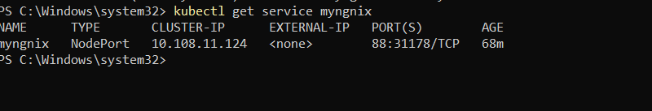
Use the existing service
kubectl get service myngnix
Here 30088 is the NodePort on your host.
Port-forward to localhost (most reliable on Windows)

Slide 52
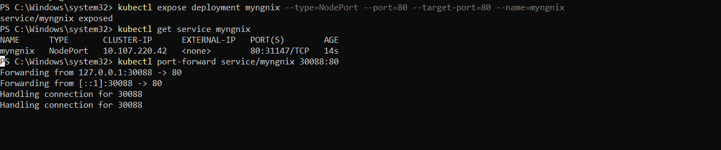
Port-forward to localhost (most reliable on Windows):
>kubectl port-forward service/myngnix 30088:80

Slide 53
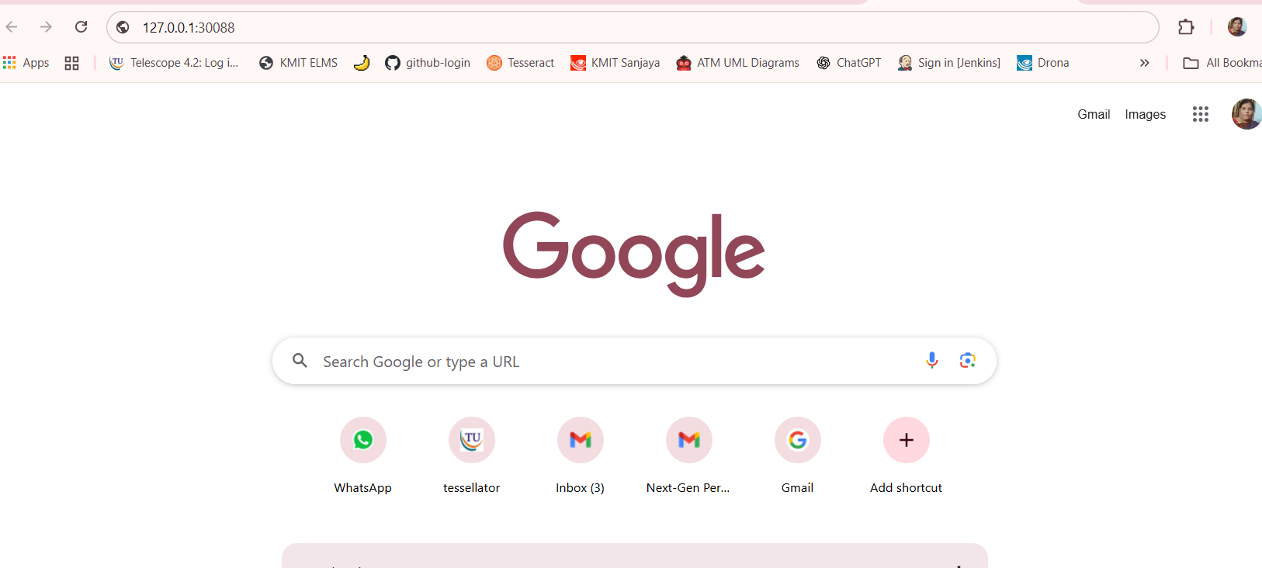
Copy and Paste the URL generated in a browser

Slide 54
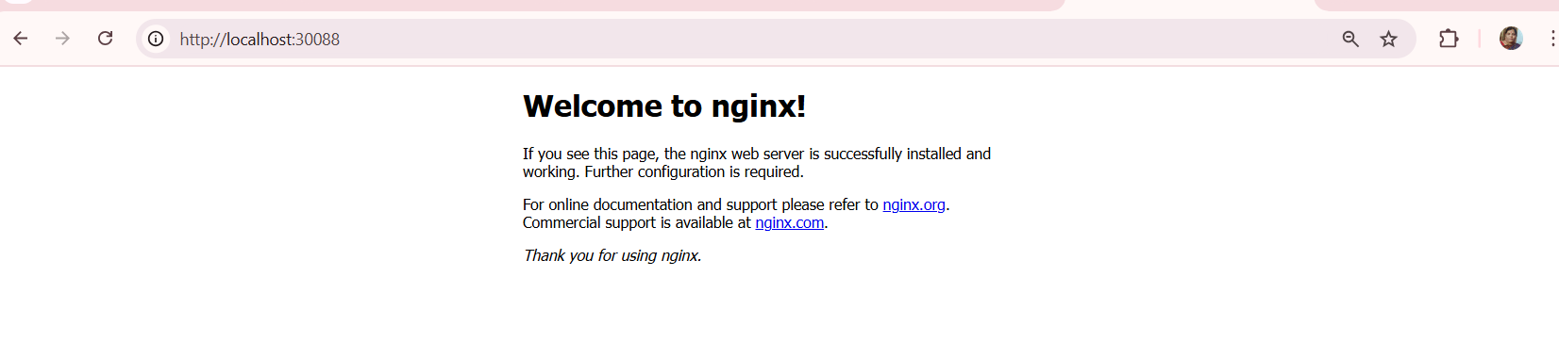
The nginx server is now accessible

Slide 55
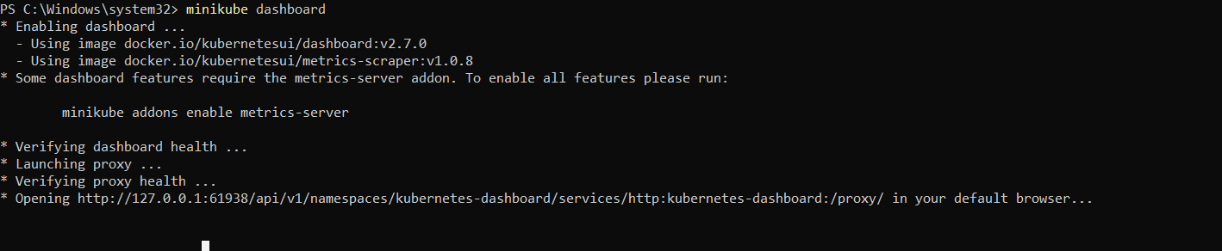
minikube dashboard
command is used to open the Kubernetes Dashboard, a web-based user interface, when you are working with Minikube.
When you run this command, Minikube will launch a web browser window or provide a URL that you can visit to access the Kubernetes Dashboard. The Dashboard is a graphical interface that allows you to monitor and manage different aspects of your local Kubernetes cluster, such as viewing running pods, services, deployments, and more. It's a useful tool for visualizing and interacting with your Kubernetes resources during development and testing.

Slide 56

Minikube dashboard

Slide 57

you van see deployment of myngnix

Slide 58

4 replicas of myngnix

Slide 59

kubectl delete deployment myngnix1
this command is telling Kubernetes to delete the deployment named "myngnix1" along with its associated resources (like pods).
The command minikube stop is used to stop a running Minikube cluster. Minikube is a tool that allows you to run Kubernetes clusters locally for development and testing purposes.
When you run minikube stop, it halts the operation of the Minikube cluster, suspending the virtual machines and freeing up system resources on your local machine. This is useful when you're done working with the cluster and want to conserve resources or when you need to temporarily pause the cluster. You can later use minikube start to resume the cluster from where you left off.

Slide 60
THE END

